Slide 1

Hotel Booking Data Analysis
Team Members:
Hazem Elsheikh
Moaz Mohammed
Mostafa Saad
Cellula Technologies
Machine Learning Internship
Week 2

Slide 2
Data Preprocessing

Slide 3
Data Preprocessing
Common Steps
Converted date_of_reservation to datetime format
Removed Booking_ID column
Removed duplicate rows
Handled missing values (either by checking or dropping)
Standardized column names (e.g., stripped whitespace or unified formatting)
Differences Between Approaches
Hazem:
Fixed an invalid date entry (2018-2-29) instead of dropping it
Verified that no missing values remained without dropping them blindly
Moaz:
Used .dropna() to remove rows with missing values directly
Did not handle the invalid date entry specifically

Slide 4
Outliers

Slide 5
Outliers
Common Steps
Visualized numeric features using boxplots
Focused on handling outliers in the "lead time" column
Differences Between Approaches
Hazem:
Used histograms to assess distribution
Applied log transformation to "lead time"
Checked skewness before and after transformation
Moaz:
Used IQR (Interquartile Range) to handle outliers in "lead time"
Mostafa:
Used both boxplots and distribution plots
Applied IQR capping method to treat outliers

Slide 6
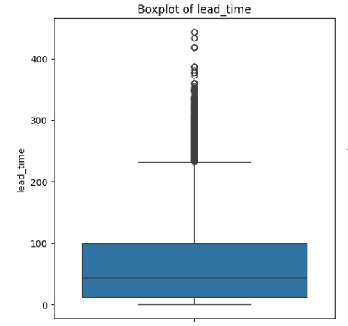
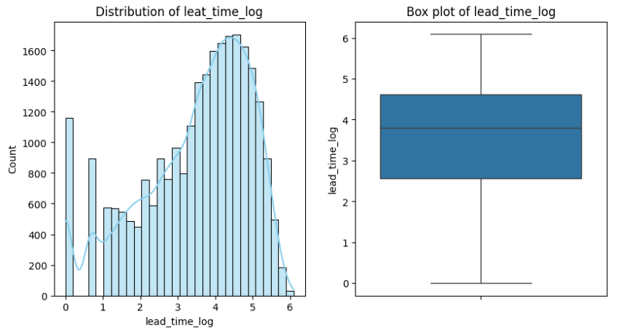

Slide 7
Feature Engineering

Slide 8
Feature Engineering
Common Steps
Encoded target variable "booking_status" to binary (Canceled = 0, Not_Canceled = 1)
Applied Label Encoding and One-Hot Encoding for categorical variables
Removed unnecessary features

Slide 9
Feature Engineering
Differences Between Approaches
Hazem
Created new features:
all_people = adults + children
all_nights = weekend nights + week nights
has_previous_cancelation flag from p-c
booking_ratio = p-c / (p-c + p-not-c)
Converted “room_type” and “type_of_meal” to numeric manually
Moaz:
Applied feature selection using:
SelectKBest with chi2
mutual_info_classif
Scaled numerical features using StandardScaler
Mostafa:
Removed highly correlated features (correlation > 0.85)
Dropped irrelevant columns (Booking_ID, date_of_reservation)
Handled class imbalance using SMOTE
Scaled features using StandardScaler

Slide 10
Modeling

Slide 11
Modeling
Common Steps
Built and trained a Logistic Regression model
Evaluated models using:
Accuracy Score
Confusion Matrix
Classification Report

Slide 12
Modeling
Differences Between Approaches
Hazem:
Checked multicollinearity using VIF
Decided not to drop high VIF features
Performed train/test split: 80% training, 20% testing
Achieved:
Accuracy = 0.81
Cross-validation score = 0.80
Moaz:
Used multiple models:
Logistic Regression
Random Forest
Gradient Boosting
Support Vector Machine (SVM)
Included additional evaluation metric: ROC-AUC Score
Performed Cross-Validation and GridSearchCV for hyperparameter tuning
Mostafa:
Used:
Logistic Regression
Random Forest

Slide 13
Modeling
Hazem
Moaz
Mostafa
Created a logistics regression model
Choose the final features to be used for the model
Checked multicollinearity with VIF
did not actually remove the features with high VIF value
Performed train/test split
train = 0.8
test =0.2
Evaluated model using:
Accuracy Score
Accuracy = 0.81
Classification Report
Confusion Matrix
Cross-validation scores
Score = 0.8
Models used:
Logistic Regression
Random Forest
Gradient Boosting
Support Vector Machine (SVM)
Evaluated using:
Accuracy Score
Confusion Matrix
ROC-AUC Score
Classification Report
Performed Cross-Validation and GridSearchCV for tuning
Models used:
Logistic Regression
Random Forest
Evaluated using:
Accuracy Score
Confusion Matrix
Classification Report

Slide 14
Thank You

